Slide 1
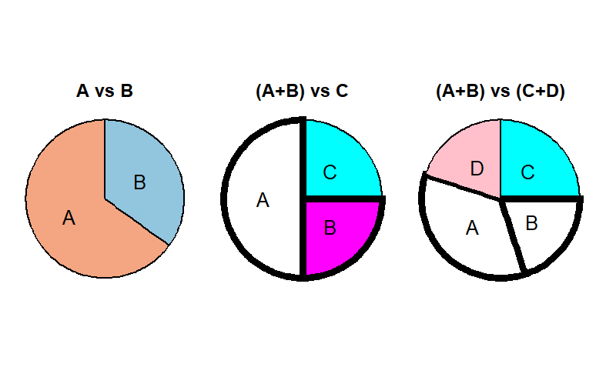
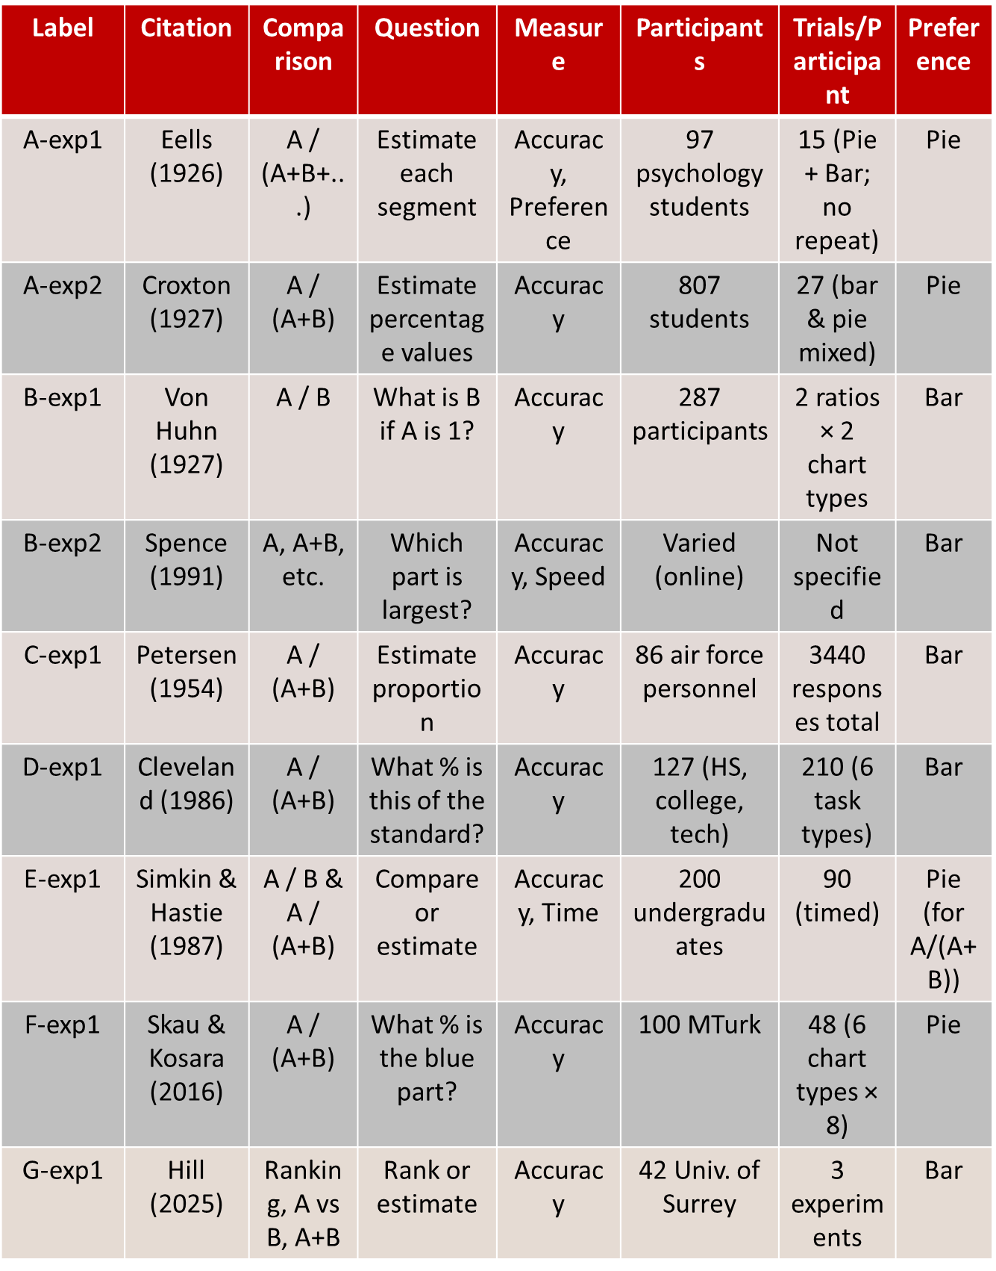
100 Years of Pies vs Bars
Maksuda Toma and Susan Vanderplas
Statistics Department, University of Nebraska Lincoln
Abstract
The debate between pie charts and bar charts has persisted for over a century, yet no definitive consensus has emerged regarding which is more effective. This poster offers a comprehensive summary of the historical and empirical literature, analyzing the strengths and limitations of each chart type. Pie and bar charts were introduced by William Playfair in the early 1800s. By the early 20th century, strong criticisms of pie charts appeared in textbooks and design manuals. Brinton (1914) and Karsten (1923), for example, labeled pie charts as cognitively inefficient and even insulting to the reader's intelligence. Eells (1926) noted that while the sector method (pie chart) was common, horizontal bar charts were favored for speed and accuracy. Despite longstanding criticism, pie charts remain widely used today. This work synthesizes findings from early visual perception studies through to modern experiments (Spence & Lewandowsky, 1991), highlighting that chart effectiveness often depends on task complexity. We aim to bridge historical insights with current empirical evidence to provide design guidance on when pie or bar charts are most appropriate.
Summary of Experimental Studies on Chart Perception
Conclusion
As of now, no one has determined a definitive winner between pie charts and bar charts. These two charts remain essential in every part of science, business, sociology, and related fields. The efficacy of various charts is contingent upon ratio, measurement, and perception aspects of the representation. In research, a chart should not be dismissed solely because it is deemed inadequate. Pie charts make it easier to assess proportions relative to the whole, but bar charts excel in comparing magnitudes and ranking activities. Performance fluctuates depending on whether the task entails value estimation, segment comparison, or identification of the major component. Generally, charts that clearly delineate comparative parts (e.g., adjacent slices or bold outlines) enhance interpretability. We have also discovered an intriguing fact that, despite the evolution of formats and digital interfaces, fundamental perceptual concepts (from Eells, Cleveland, & McGill, etc.) continue to have validity. Nonetheless, this finding does not signify the conclusion of the pursuit for the optimal chart. Future research can clarify the dispute through improved experimental design and more compelling methodologies.
Result
The effectiveness of pie, bar charts depends heavily on the task type. A vs B (Direct Comparison): Bar charts perform best in accuracy, speed, and user preference for comparing two values A / (A + B) (Part-to-Whole Estimation): Pie charts lead to more accurate judgments in part-to-whole tasks, especially with simple, adjacent segments. However, their advantage may decline when comparing non-adjacent slices in 3–4 component pies. A vs (B + C), A+B vs C+D (Grouped Comparison): Results are mixed. Bar charts are slightly better for A vs B+C, while pie charts outperform for grouped comparisons like A+B vs C+D Ranking Tasks: Bar charts enable faster and more accurate ranking of multiple parts due to clear alignment Magnitude Estimation: Pie and donut charts tend to support better intuitive magnitude judgments, although slight estimation errors are more common
Experimental Description
This project synthesizes almost a century of experimental research comparing pie charts and bar charts for part-whole data display Early research (Eells, 1926; Croxton, 1927; Von Huhn, 1927) focused on proportion estimation. Participants estimated chart section percentages. Both studies found that pie charts were more accurate, especially with equal-sized or many components. Comparison-based activities (Von Huhn, 1927) tested magnitude comparison skills by comparing A and B. Recent research has expanded visual tasks (Spence 1991; Simkin 1987). They compared bar, pie, and table charts in timed and untimed activities like A against B+C and A+B vs C+D. The graphical perception framework by Cleveland and MacGill (1984–1986) examined how visual encodings like position, length, angle, and area affect judgment accuracy. New online studies by Skau & Kosara (2016) and Hill (2025) examined perceptual biases and distortions. They showed that exploding or elliptical pies reduce accuracy, while standard pie charts are still successful in part-whole estimate tasks. Hill also examined ranking and size estimation, proving that no chart form works well for all tasks.
Future Research
Numerous constraints are present in both early and contemporary investigations. Initial trials (from the 1920s to 1980s) frequently exhibited insufficient statistical rigor, characterized by delicate measurement frameworks and rudimentary designs. Contemporary research (Spence1991; Hill2025) has implemented enhanced experimental designs, however, it continues to encounter difficulties, especially with participant diversity. Contemporary research predominantly utilizes student samples, so constrains generalizability and potentially fails to represent wider perceptual disparities across age, education, or cultural contexts. Subsequent investigations ought to tackle this issue by enhancing sample variety and refining experimental methodologies. This may reveal fresh insights and promote more inclusive, contextually suitable chart type.
Best Uses of Chart
Pie | Bar
Part-to-whole estimation | Comparing individual parts
Magnitude Estimation | Ranking, or scanning values
Note: Avoid pie charts when comparing non-adjacent slices or judging small differences
Reference
Cleveland, McGill. 1984 https://doi.org/10.1080/01621459.1984.10478080 Croxton, Stryker; 1927 https://doi.org/10.2307/2276829 Skau, Kosara; 2016 https://doi.org/10.1111/cgf.12888

